Slide 1
Physical Chemistry III
2022.03.21

Slide 2
Index of contents
Schrödinger equation – History
Bra-ket notation
Particle in a box

Slide 3
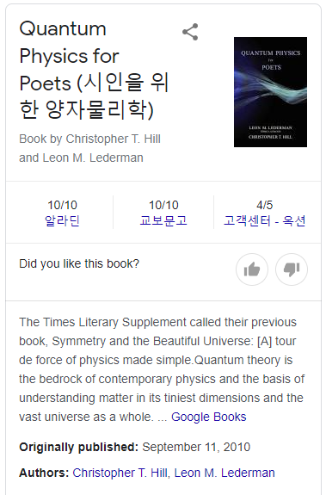

Slide 4
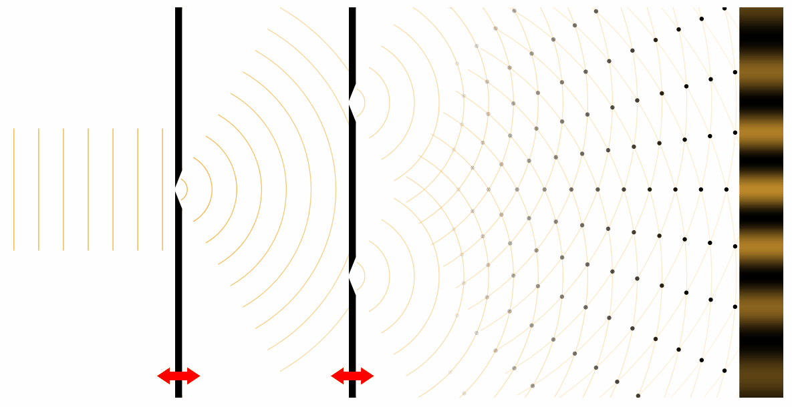
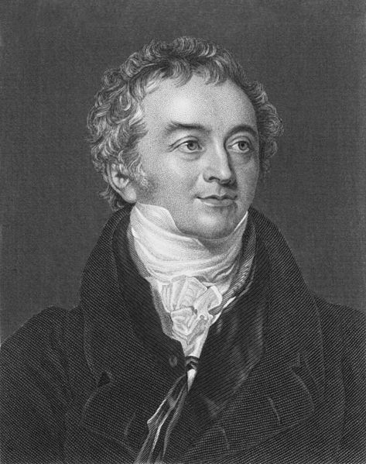
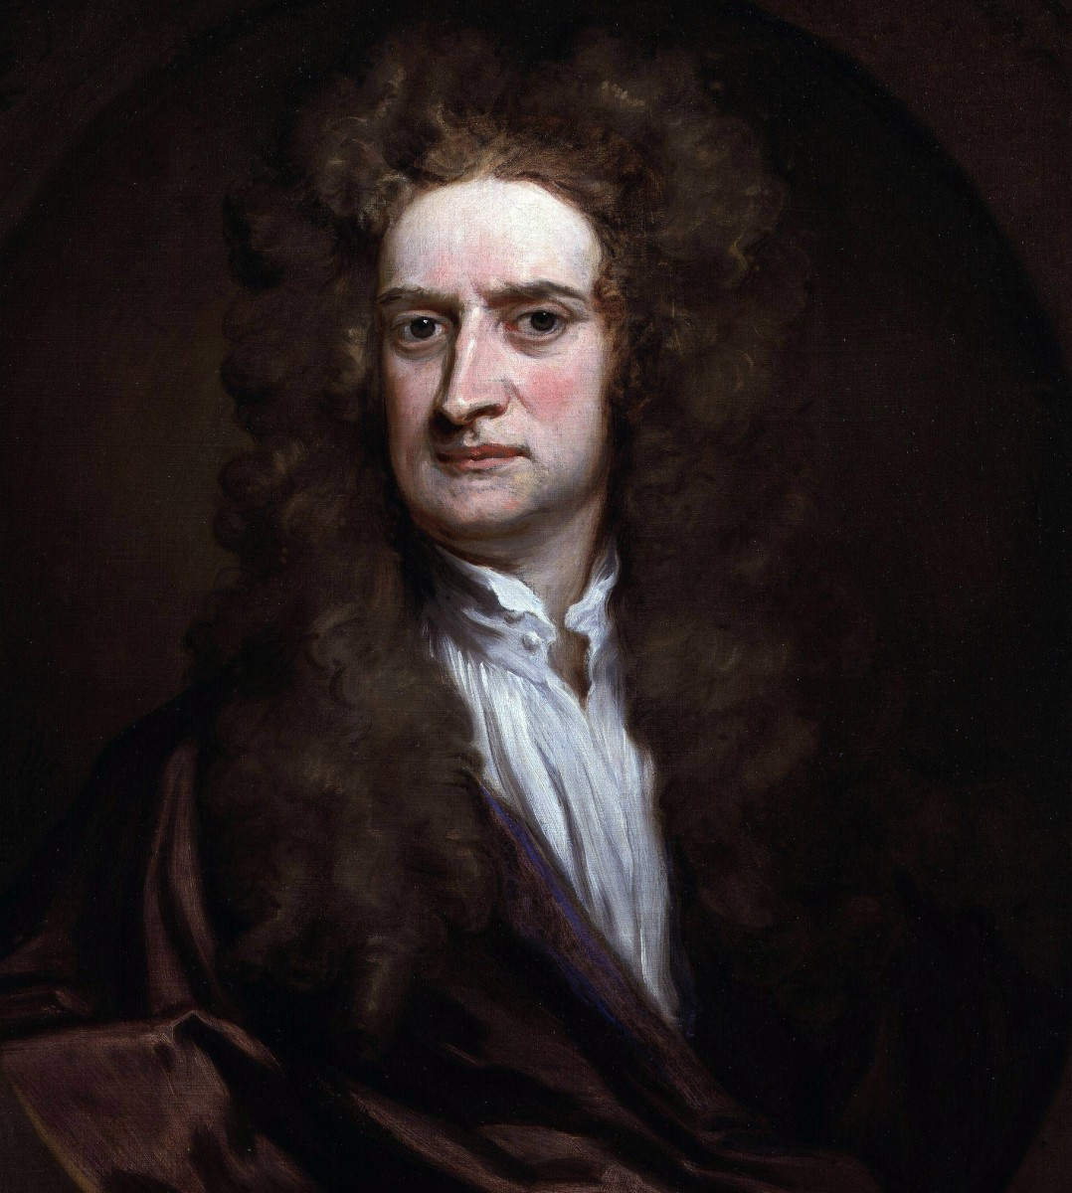
Double slit experiment
Light is made up of small discrete particles!
In 1801, Thomas Young
https://javalab.org/en/youngs_double_slit_en/
No. You wrong.
Light is wave.

Slide 5
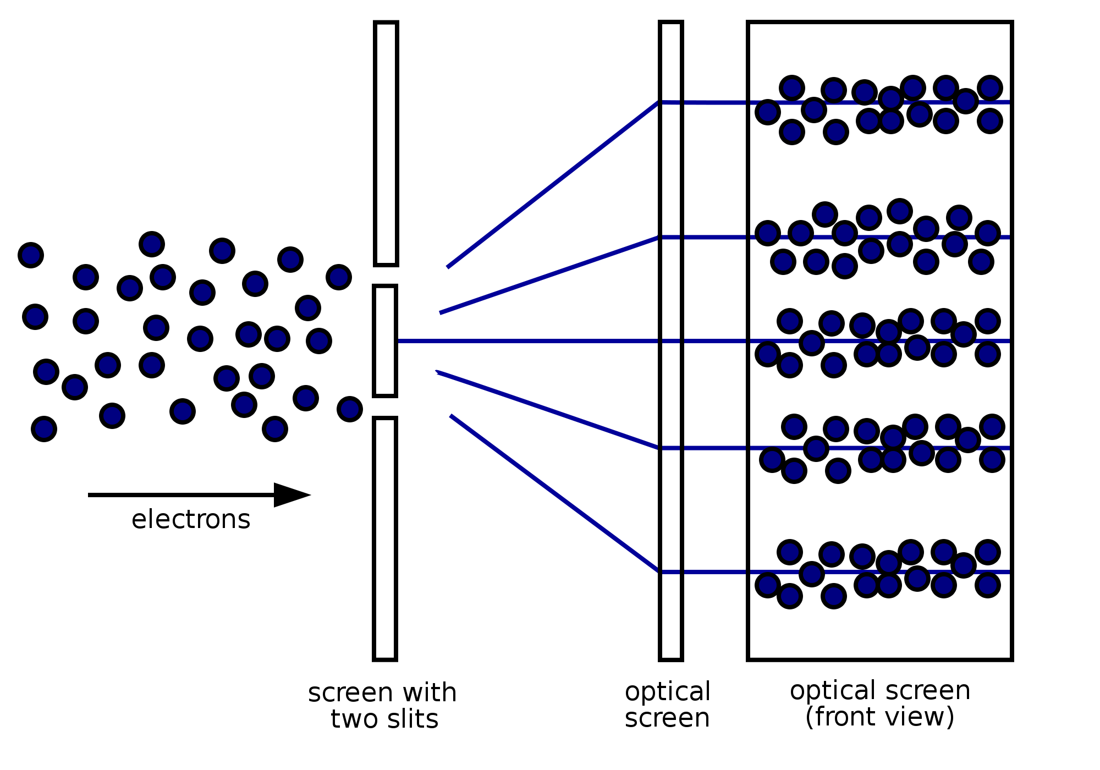
Double slit experiment
In 1801, Thomas Young
In 1927 at Bell Labs, Clinton Davisson and Lester Germer
https://javalab.org/en/youngs_double_slit_en/
Electron is wave..?

Slide 6
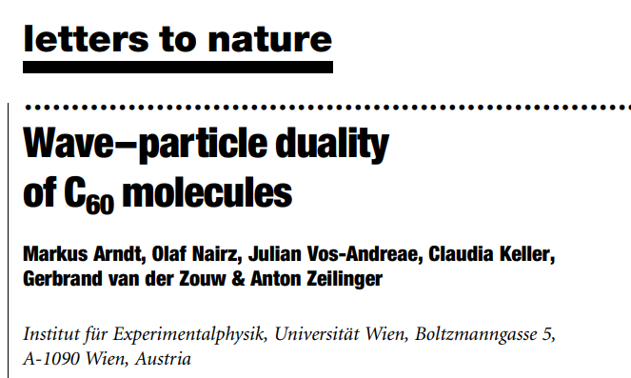
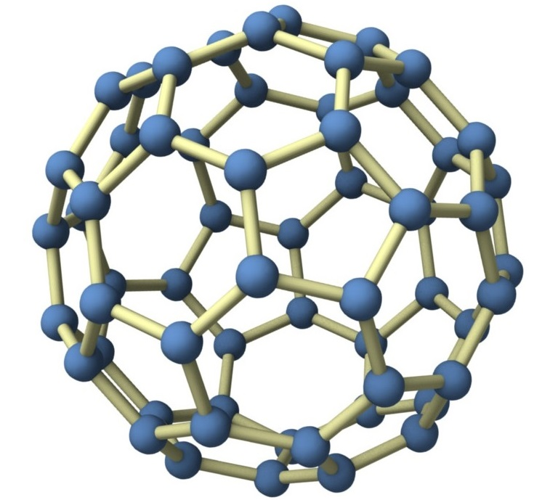
Double slit experiment
In 1801, Thomas Young
https://javalab.org/en/youngs_double_slit_en/
Am I wave?

Slide 7
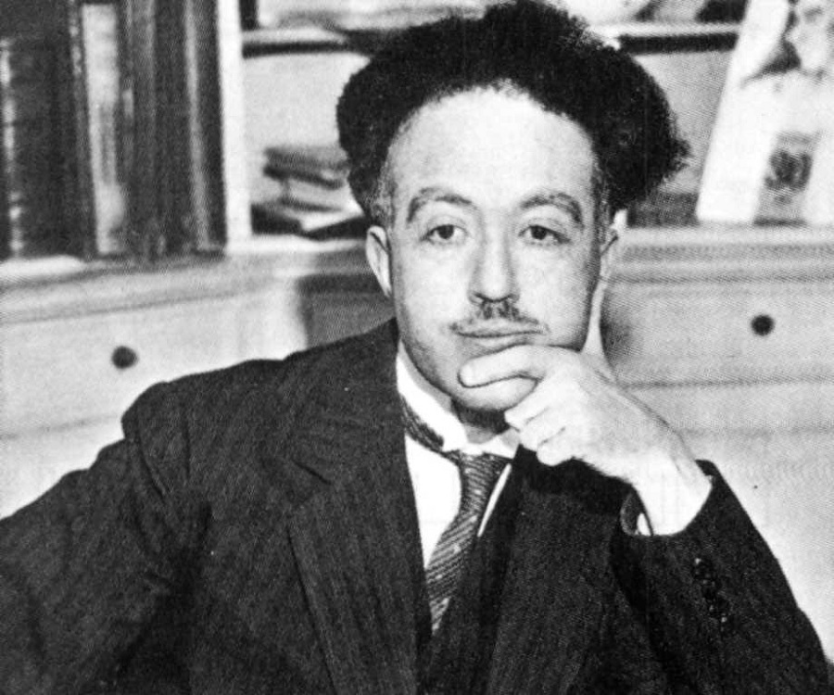
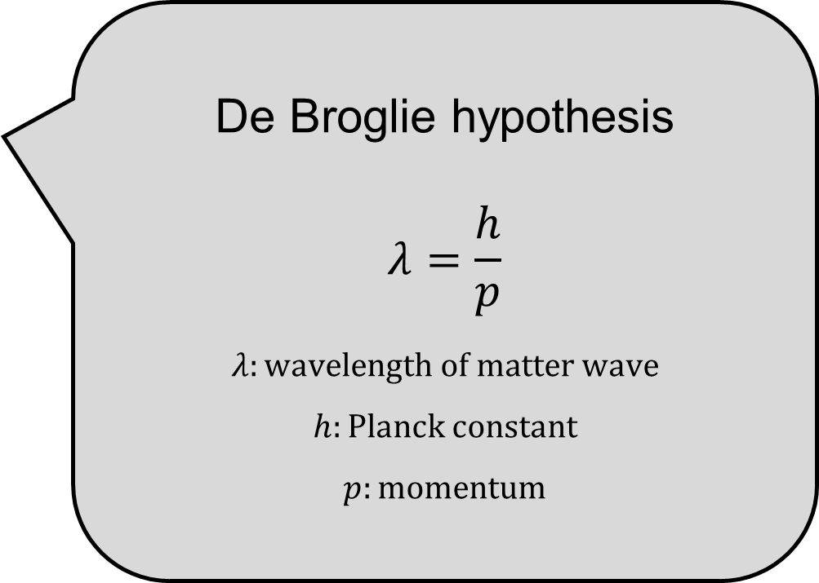
Matter wave
In 1924, De Broglie (Ph.D student)
De Broglie hypothesis
$$λ=\frac{h}{p}$$
$$λ:wavelength of matter wave$$
$$h:Planck constant$$
$$p:momentum$$

Slide 8
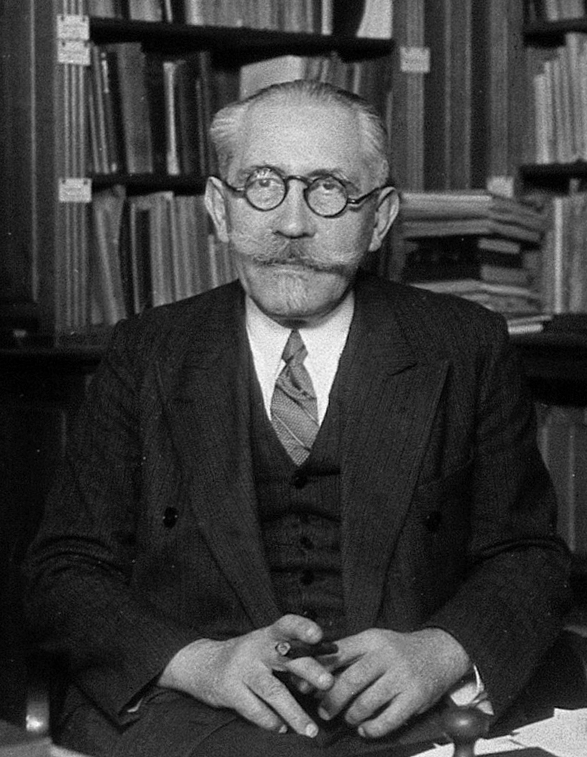
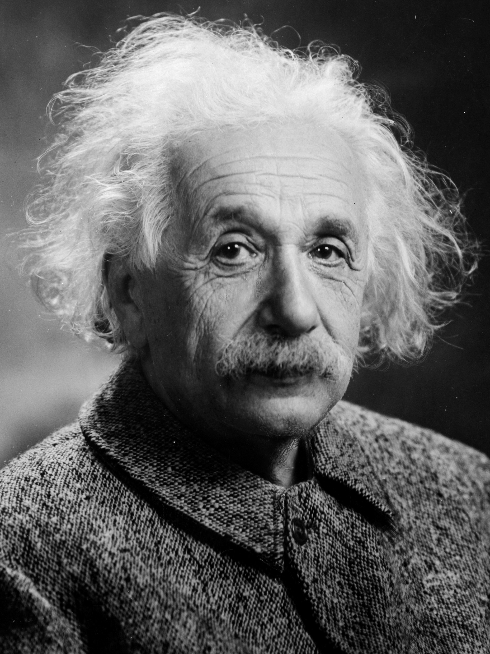
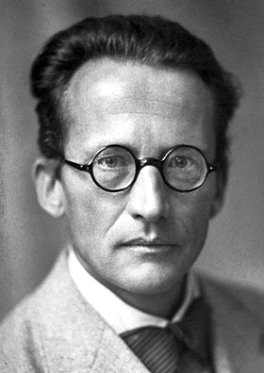
Matter wave
Paul Langevin (Professor of Broglie)
Albert Einstein (Friend of Langevin)
De Broglie (Ph.D student)
Erwin Schrödinger (Research assistant of Einstein)

Slide 9
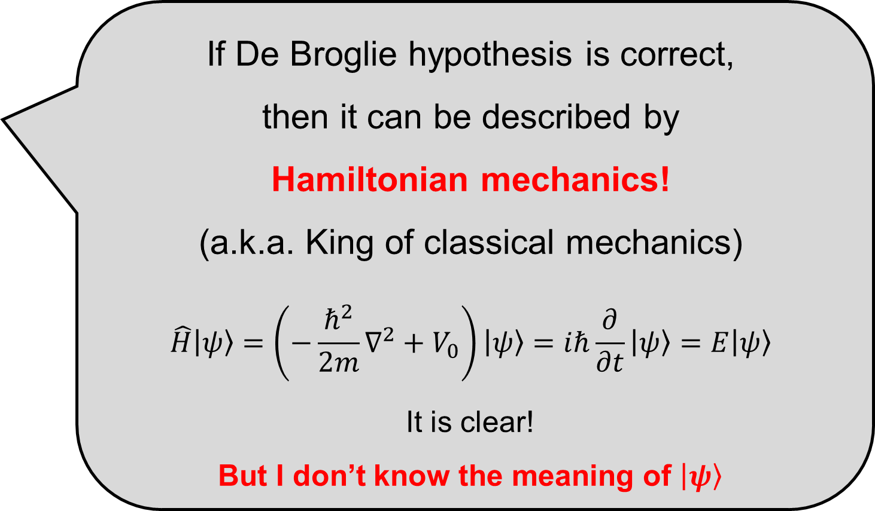
Schrödinger Equation
In 1925, (published in 1926)
If De Broglie hypothesis is correct,
then it can be described by
Hamiltonian mechanics!
(a.k.a. King of classical mechanics)
$$\hat{H}\left|ψ\right\rangle =\left(−\frac{ℏ^{2}}{2m}∇^{2}+V_{0}\right)\left|ψ\right\rangle =iℏ\frac{∂}{∂t}\left|ψ\right\rangle =E\left|ψ\right\rangle$$
It is clear!
But I don’t know the meaning of $\left|ψ\right\rangle$

Slide 10
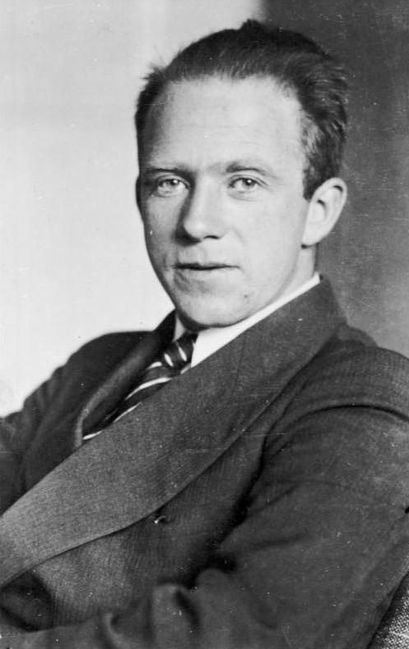
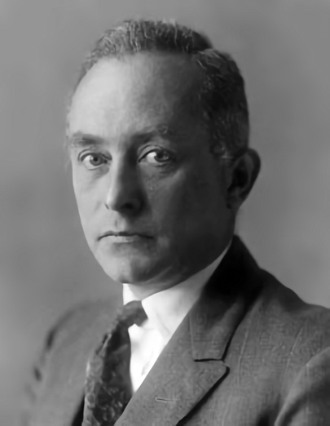
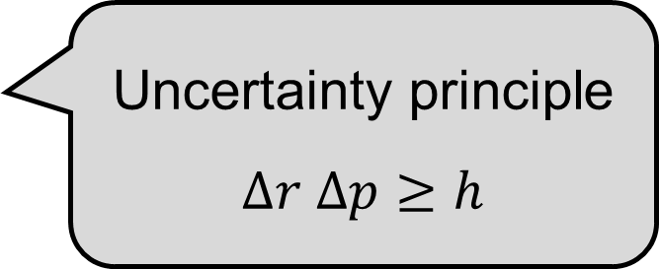
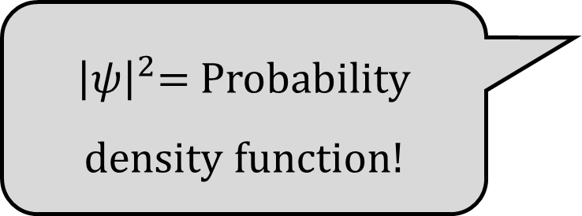
After Schrödinger Equation
In 1926,
Uncertainty principle
$$∆r ∆p≥h$$
${\left|ψ\right|}^{2}$= Probability density function!
Werner Heisenberg
Max Born

Slide 11
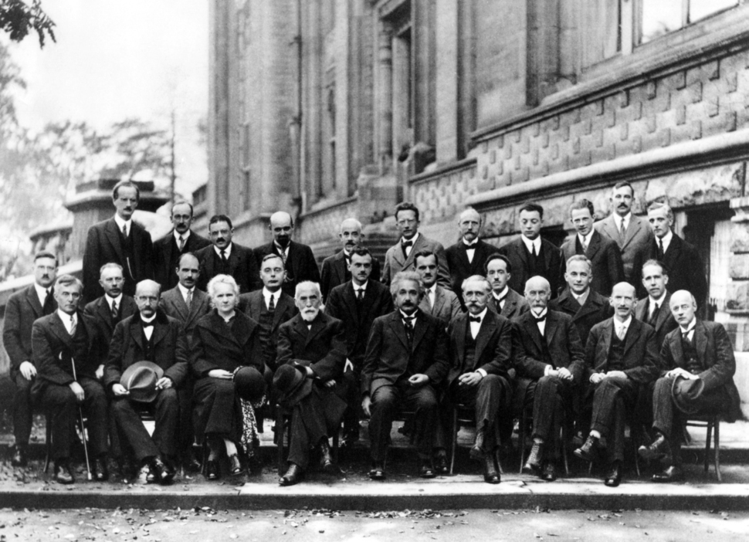
After Schrödinger Equation
Erwin Schrödinger
Werner Heisenberg
In 1927 Brussels conference..
De Broglie
Max Born
Albert Einstein
Paul Langevin

Slide 12
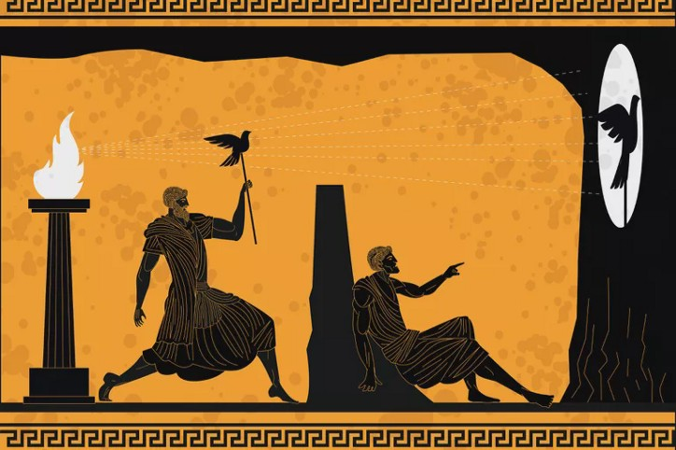
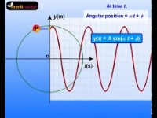
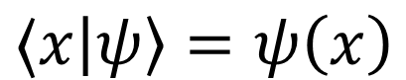
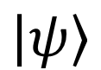
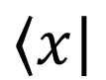
$$\left\langle x\right|$$
$$\left|ψ\right\rangle$$
$$⟨x\left|ψ\right\rangle =ψ\left(x\right)$$

Slide 13

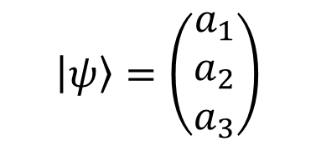
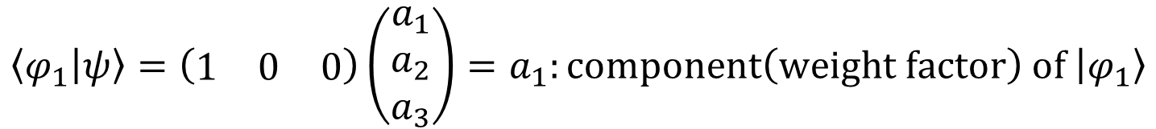
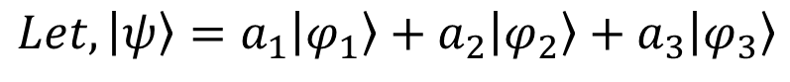
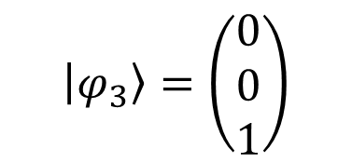
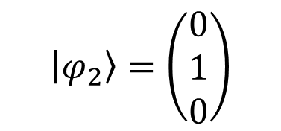
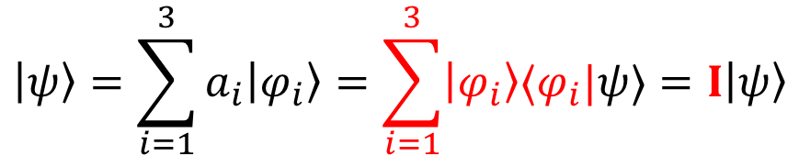
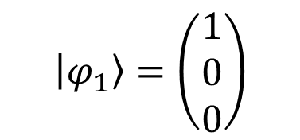
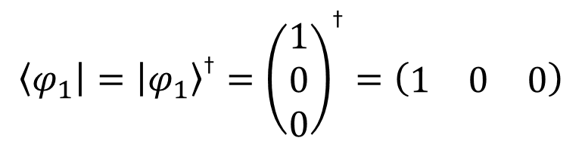
$$Let, \left|ψ\right\rangle =a_{1}\left|φ_{1}\right\rangle +a_{2}\left|φ_{2}\right\rangle +a_{3}\left|φ_{3}\right\rangle$$
$$\left|φ_{1}\right\rangle =\left(\begin{matrix}1 \\ 0 \\ 0\end{matrix}\right)$$
$$\left|φ_{2}\right\rangle =\left(\begin{matrix}0 \\ 1 \\ 0\end{matrix}\right)$$
$$\left|φ_{3}\right\rangle =\left(\begin{matrix}0 \\ 0 \\ 1\end{matrix}\right)$$
Orthonormal basis
$$\left|ψ\right\rangle =\left(\begin{matrix}a_{1} \\ a_{2} \\ a_{3}\end{matrix}\right)$$
$$\left\langle φ_{1}\right|={\left|φ_{1}\right\rangle }^{\text{†}}={\left(\begin{matrix}1 \\ 0 \\ 0\end{matrix}\right)}^{\text{†}}=\left(\begin{matrix}1 & 0 & 0\end{matrix}\right)$$
$$a_{1}^{ 2}+a_{2}^{ 2}+a_{3}^{ 2}=1$$
$$\left\langle φ_{1} | ψ\right\rangle =\left(\begin{matrix}1 & 0 & 0\end{matrix}\right)\left(\begin{matrix}a_{1} \\ a_{2} \\ a_{3}\end{matrix}\right)=a_{1}:component\left(weight factor\right) of \left|φ_{1}\right\rangle$$
$$\left|ψ\right\rangle =\sum_{i=1}^{3}{a_{i}\left|φ_{i}\right\rangle }=\sum_{i=1}^{3}{\left|φ_{i}\right\rangle ⟨φ_{i}|ψ⟩}=I\left|ψ\right\rangle$$

Slide 14
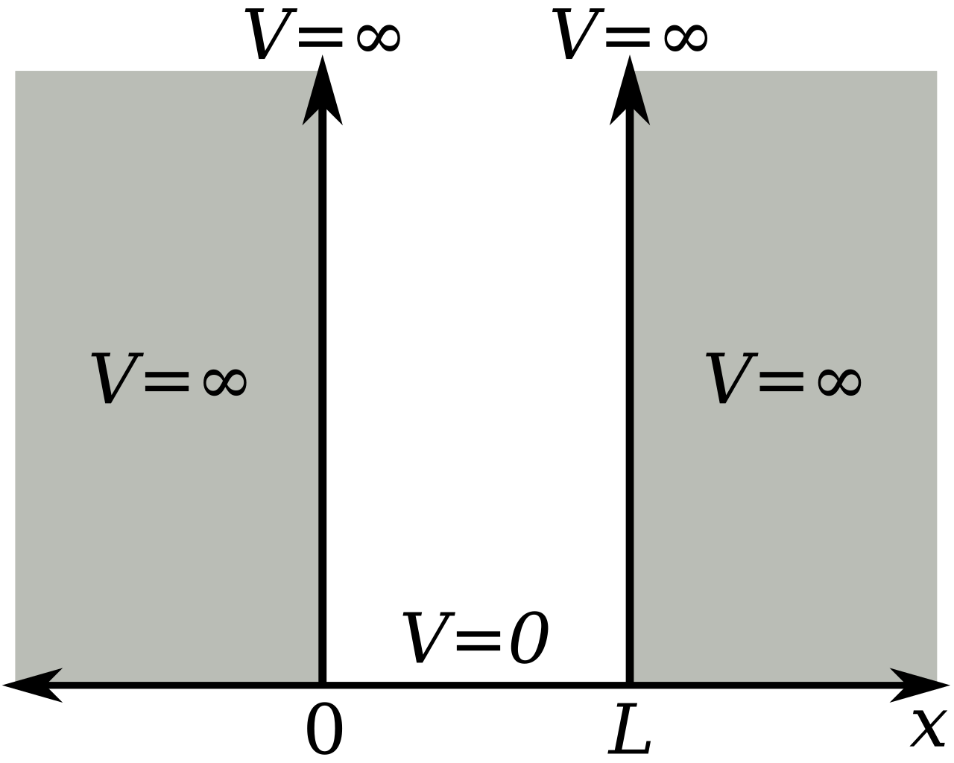
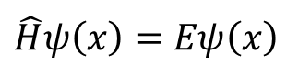
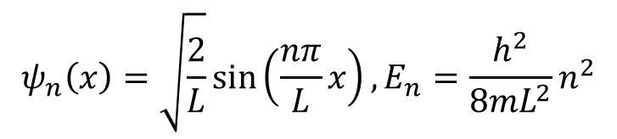
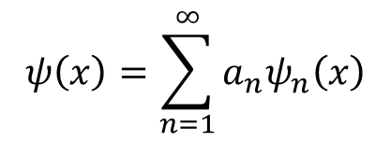
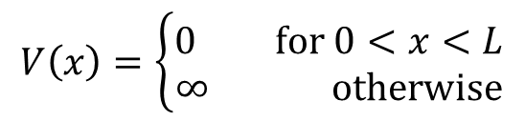
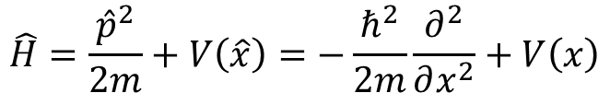
Particle in a box
$$\hat{H}ψ\left(x\right)=Eψ\left(x\right)$$
$$\hat{H}=\frac{{\hat{p}}^{2}}{2m}+V\left(\hat{x}\right)=−\frac{ℏ^{2}}{2m}\frac{∂^{2}}{∂x^{2}}+V\left(x\right)$$
$$V\left(x\right)=\left\{\begin{aligned}0 for 0<x<L \\ ∞ otherwise\end{aligned}\right.$$
$$ψ\left(x\right)=\sum_{n=1}^{∞}{a_{n}ψ_{n}\left(x\right)}$$
$$ψ_{n}\left(x\right)=\sqrt{\frac{2}{L}}\sin\left(\frac{nπ}{L}x\right), E_{n}=\frac{h^{2}}{8mL^{2}}n^{2}$$
https://github.com/thereexist/Physical_chemistry_3/blob/main/Particle_in_a_box/particle_in_a_box.ipynb

